Slide 1
Variables/Assignments
Module 2

Slide 2
Module 2 Topics
Variables and Literals
Primitive Data Types
Arithmetic Operators
Conversion between Primitive Data Types
Creating named constants with final
The String class
Scope
Comments
Reading keyboard input
The System.out.printf method

Slide 3
Variables and Literals
A variable is a named storage location in the computer’s memory.
A literal is a value that is written into the code of a program.
Programmers determine the number and type of variables a program will need.

Slide 4
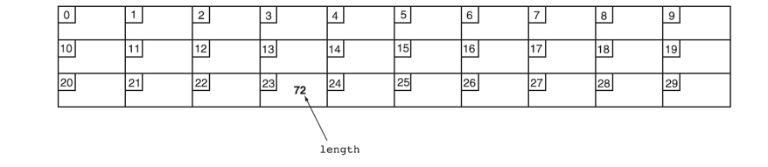
Variables
Variables are simply a name given to represent a place in memory.
A variable name represents a location in memory

Slide 5
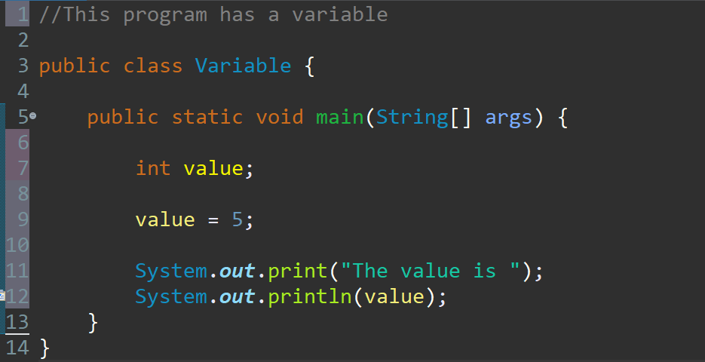
Variables and Literals
Line 7 contains a variable declaration.
Variables must be declared before they are used.
A variable declaration tells the compiler the variable’s name and the type of data it will hold.
This variable’s name is value, and the word int means that it will hold an integer value.
Notice that variable declarations end with a semicolon.
Variable Declaration

Slide 6
Variables and Literals
Line 9 contains an assignment statement.
The equal sign is an operator that stores the value on its right (in this case 5) into the variable named on its left.
After this line executes, the value variable will contain the value 5.
Line 9 doesn’t print anything. It runs silently behind the scenes.
Assignment Statement

Slide 7
Variables and Literals
Line 10 sends the string literal "The value is " to the print method.
Line 11 send the name of the value variable to the println method.
When you send a variable name to print or println, the variable’s contents are displayed.
Notice there are no quotation marks around the variable value.
Display String Literal
Display Variable’s Contents

Slide 8
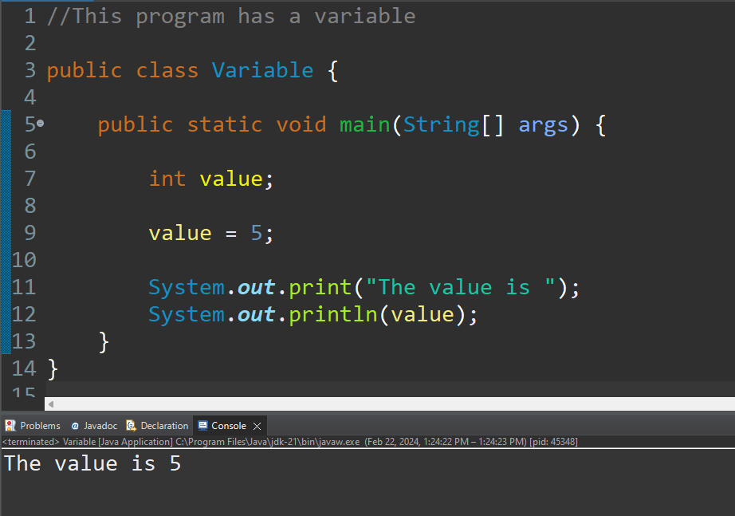
Variables and Literals

Slide 9
Displaying Multiple Items with the + Operator
The + operator can be used in two ways.
as a concatenation operator
as an addition operator
If either side of the + operator is a string, the result will be a string.
System.out.println("Hello " + "World");
System.out.println("The value is: " + 5);
System.out.println("The value is: " + value);
System.out.println("The value is: " + '/n' + 5);

Slide 10
String Concatenation
A string literal value cannot span lines in a Java source code file.
System.out.println("This line is too long and now it has spanned more than one line, which will cause a syntax error to be generated by the compiler. ");

Slide 11
String Concatenation
The String concatenation operator can be used to fix this problem.
System.out.println("These lines are " +
"now ok and will not " +
"cause the error as before.");
String concatenation can join various data types.
System.out.println("We can join a string to " +
"a number like this: " + 5);

Slide 12
String Concatenation
The Concatenation operator can be used to format complex String objects.
System.out.println("The following will be printed " +
"in a tabbed format: " +
"\n\tFirst = " + 5 * 6 + ", " +
"\n\tSecond = " + (6 + 4) + "," +
"\n\tThird = " + 16.7 + ".");
Notice that if an addition operation is also needed, it must be put in parenthesis.

Slide 13
Identifiers
Identifiers are programmer-defined names for:
classes
variables
methods
Identifiers may not be any of the Java reserved key words.

Slide 14
Identifiers
Identifiers must follow certain rules:
An identifier may only contain:
letters a–z or A–Z,
the digits 0–9,
underscores ( _ ), or
the dollar sign ( $ )
The first character may not be a digit.
Identifiers are case sensitive.
itemsOrdered is not the same as itemsordered.
Identifiers cannot include spaces.

Slide 15
Class Names
Variable names should begin with a lowercase letter and then capitalize the first letter of each word thereafter:
Ex: int numCharacters
Class names should begin with a capital letter and each word thereafter should be capitalized.
Ex: public class ClassLecture
This helps differentiate the names of variables from the names of classes.

Slide 16
Primitive Data Types
Primitive data types are built into the Java language and are not derived from classes.
There are 8 Java primitive data types.
byte
short
int
long
float
double
boolean
char

Slide 17
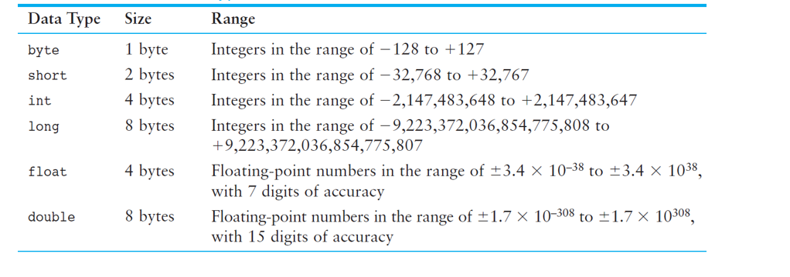
Numeric Data Types

Slide 18
Variable Declarations
Variable Declarations take the following form:
DataType VariableName;
byte inches;
short month;
int speed;
long timeStamp;
float salesCommission;
double distance;

Slide 19
Integer Data Types
byte, short, int, and long are all integer data types.
They can hold whole numbers such as 5, 10, 23, 89, etc.
Integer data types cannot hold numbers that have a decimal point in them.
Integers embedded into Java source code are called integer literals.

Slide 20
Floating-Point Data Types
Data types that allow fractional values are called floating-point numbers.
1.7 and -45.316 are floating-point numbers.
In Java there are two data types that can represent floating-point numbers.
float - also called single precision
(7 decimal points)
double - also called double precision
(15 decimal points)

Slide 21
Floating-Point Literals
When floating-point numbers are embedded into Java source code, they are called floating-point literals.
The default data type for floating-point literals is double.
29.75, 1.76, and 31.51
Java is a strongly-typed language

Slide 22

Floating-Point Literals (cont’d.)
Literals cannot contain embedded currency symbols or commas.
grossPay = $1,257.00; // ERROR!
grossPay = 1257.00; // Correct.
Floating-point literals can be represented in scientific notation.
47,281.97 == 4.728197 x 10⁴.
Java uses E notation to represent values in scientific notation.
4.728197X10⁴ == 4.728197E4.

Slide 23
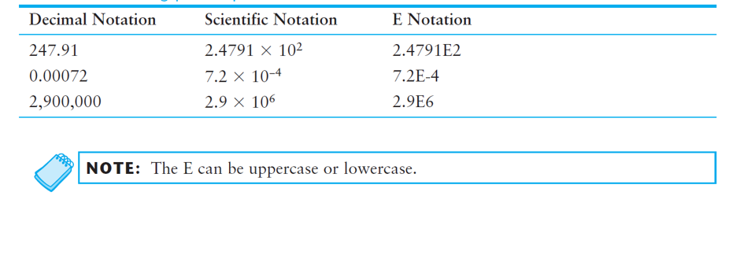
Scientific and E Notation

Slide 24

The boolean Data Type
The Java boolean data type can have two possible values.
true
false
The value of a boolean variable may only be copied into a boolean variable.

Slide 25
The char Data Type
The Java char data type provides access to single characters.
char literals are enclosed in single quote marks.
'a', 'Z', '\n', '1'
Don’t confuse char literals with string literals.
char literals are enclosed in single quotes.
String literals are enclosed in double quotes.

Slide 26
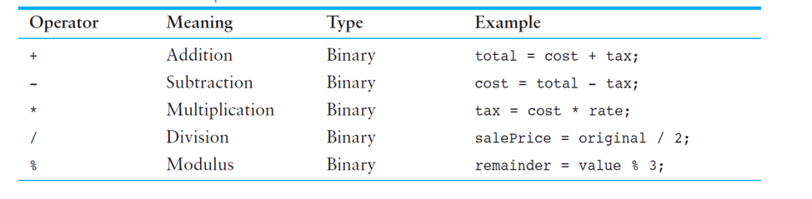
Arithmetic Operators

Slide 27
Integer Division
Division can be tricky.
In Java, what is the value of 1/2?
You might think the answer is 0.5. This is incorrect.
The answer is simply 0.
Integer division will truncate any decimal remainder.

Slide 28
Operator Precedence
Mathematical expressions can be very complex.
There is a set order in which arithmetic operations will be carried out.
Operator | Associativity | Example | Result
- (unary negation) | right to left | x = -4 + 3; | -1
* / % | left to right | x = -4 + 4 % 3 * 13 + 2; | 11
+ - | left to right | x = 6 + 3 – 4 + 6 * 3; | 23
Higher
Priority
Lower
Priority

Slide 29
The Math Class
The Java API provides a class named Math, which contains several methods that are useful for performing complex mathematical operations.
In Java, raising a number to a power requires the Math.pow method
double result = math.pow(4.0, 2.0);
The Math.sqrt method accepts a double value as its argument and returns the square root of the value
double result = math.sqrt(9.0);

Slide 30
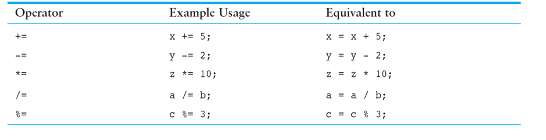
Combined Assignment Operators

Slide 31

Conversion between Primitive Data Types (cont’d.)
The Java primitive data types are ranked, as shown here:

Slide 32
Conversion between Primitive Data Types
Cast Operators
Let you manually convert a value, even if it means that a narrowing conversion will take place.
Example:
int x;
double y = 2.5;
x = (int)y;
Cast Operator

Slide 33

Creating Named Constants with final
Once initialized with a value, constants cannot be changed programmatically.
By convention, constants are all upper case and words are separated by the underscore character.
For example:
final int NUM_TIME_ZONES = 5;

Slide 34
The String Class
Java has no primitive data type that holds a series of characters.
01
The String class from the Java standard library is used for this purpose.
02
String number;
03
Notice the S in String is upper case.

Slide 35
Creating a String Object
Since String is a class, objects that are instances of it have methods.
One of those methods is the length method.
stringSize = value.length();
This statement calls the length method on the object pointed to by the value variable

Slide 36

Comments
Comments are:
notes of explanation that document lines or sections of a program.
part of the program, but the compiler ignores them.
intended for people who may be reading the source code.
In Java, there are three types of comments:
Single-line comments
Multiline comments
Documentation comments

Slide 37

Reading Keyboard Input
To read input from the keyboard we can use the Scanner class.
import java.util.Scanner;
To create a Scanner object and connect it to the System.in object:
Scanner scan = new Scanner (System.in);

Slide 38
Reading Keyboard Input
Scanner sc = new Scanner(System.in);
strings → String name = sc.nextLine();
bytes → byte b1 = sc.nextByte();
integers → int num = sc.nextInt();
long integers → long distanceToSun = sc.nextLong();
short integers → short age = sc.nextShort();
floats → float distInMeters = sc.nextFloat();
doubles → double distInCm = sc.nextDouble();

Slide 39

Reading a Character
The Scanner class does not have a method for reading a single character.
Use the Scanner class’s nextLine method to read a string from the keyboard.
Then use the String class’s charAt method to extract the first character of the string.

Slide 40
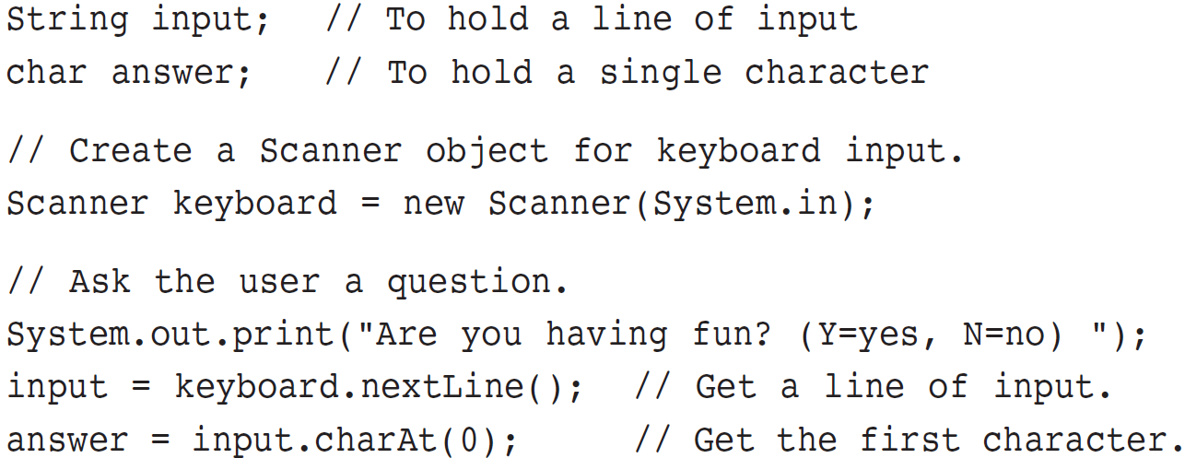
Reading a Character

Slide 41
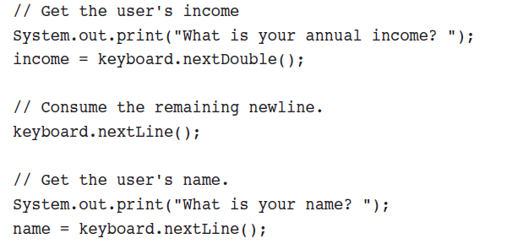
Mixing Calls to nextLine with Calls to Other Scanner Methods
Remove the newline from the keyboard buffer by calling the Scanner class’s nextLine method, ignoring the return value.
Read Primitive
Remove Newline
Read String

Slide 42
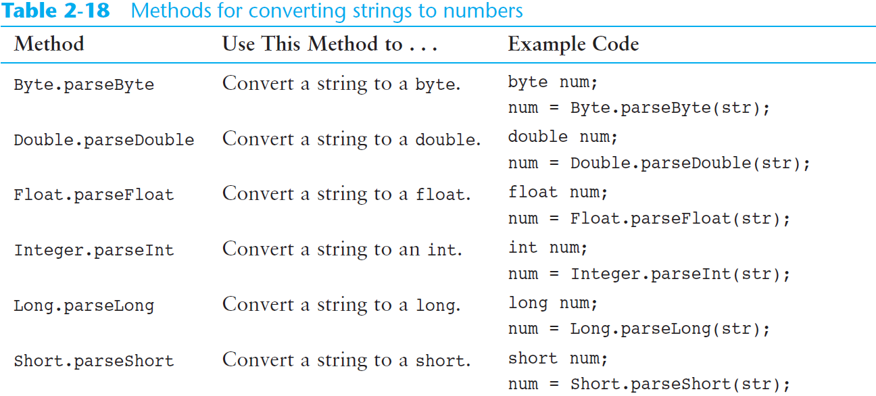
Converting a String to a Number (cont’d.)

Slide 43

Single Format Specifier and Argument
Let’s look at an example that uses a format specifier and an additional argument:
int hours = 40;
System.out.printf("I worked %d hours this week.\n",hours);
When this string is printed, the value of the hours argument will be printed in place of the %d format specifier.
I worked 40 hours this week.
The %d format specifier was used because the hours variable is an int.
An error will occur if you use %d with a non-integer value.

Slide 44
Multiple Format Specifiers and Arguments
Here’s another example:
int dogs = 2;
int cats = 4;
System.out.printf("We have %d dogs and %d cats.\n",dogs, cats);
First, notice that this example uses two %d format specifiers in the format string.
Also notice that two arguments appear after the format string.
The value of the first integer argument, dogs, is printed in place of the first %d.
The value of the second integer argument, cats, is printed in place of the second %d.
We have 2 dogs and 4 cats.

Slide 45
Multiple Format Specifiers and Arguments
The following code shows another example:
int value1 = 3;
int value2 = 6;
int value3 = 9;
System.out.printf("%d %d %d\n", value1, value2, value3);
In the printf method call, there are three format specifiers and three additional arguments after the format string.
This code will produce the following output:
3 6 9

Slide 46
Setting the Field Width
1
2
3
4
5
6
A format specifier may also include a field width. Here is an example:
int number = 9;
System.out.printf("The value is %6d\n", number);
The format specifier %6d indicates that the argument number should be printed in a field that is 6 places wide. If the value in number is shorter than 6 places, it will be right justified. Here is the output of the code.
The value is 9
If the value of the argument is wider than the specified field width, the field width will be expanded to accommodate the value.

Slide 47
Printing Formatted Floating-Point Values
If you wish to print a floating-point value, use the %f format specifier. Here is an example:
double number = 1278.92; System.out.printf("The number is %f\n", number);
This code produces the following output:
The number is 1278.920000
You can also use a field width when printing floating-point values. For example, the following code prints the value of number in a field that is 18 spaces wide:
System.out.printf("The number is %18f\n", number);

Slide 48
Printing Formatted Floating-Point Values
1
2
In addition to the field width, you can also specify the number of digits that appear after the decimal point. Here is an example:
double grossPay = 874.12; System.out.printf("Your pay is %.2f\n", grossPay);
In this code, the %.2f specifier indicates that the value should appear with two digits after the decimal point. The output of the code is:
Your pay is 874.12

Slide 49
Printing Formatted Floating-Point Values
When you specify the number of digits to appear after the decimal point, the number will be rounded. For example, look at the following code:
double number = 1278.92714; System.out.printf("The number is %.2f\n", number);
This code will produce the following output:
The number is 1278.93

Slide 50
Printing Formatted Floating-Point Values
1
2
3
4
5
6
7
8
You can specify both the field width and the number of decimal places together, as shown here:
double grossPay = 874.12; System.out.printf("Your pay is %8.2f\n", grossPay);
The output of the code is:
Your pay is 874.12

Slide 51
Printing Formatted Floating-Point Values
You can also use commas to group digits in a number. To do this, place a comma after the % symbol in the format specifier. Here is an example:
double grossPay = 1253874.12; System.out.printf("Your pay is %,.2f\n", grossPay);
This code will produce the following output:
Your pay is 1,253,874.12

Slide 52
Printing Formatted String Values
If you wish to print a string argument, use the %s format specifier. Here is an example:
String name = "Ringo";
System.out.printf("Your name is %s\n", name);
This code produces the following output:
Your name is Ringo

Slide 53
End of Module 2

